Slide 1

Matrix Solver
Notes:
This project was done during my master degree at Imperial, it was for a competition as well as part of our journey in learning c++. The library was build from scratch without having any external dependences other than standard template C++11 libraries. It was 10 days of intense development/research, time constraint being the greatest pressure factor. The challenge was to see which Team can develop most diverse set of functions as well as the most efficient ones. It helped in getting a good experience of developing real life dev practices.

Slide 2
What is it?
Matrix computations are fundamental for many applications, here it’s used to implement algorithms that solve the linear system Ab = x
Many geometry processing applications boil down to: solve one or more linear systems systems
Notes:
Matrix computations are fundamental for many applications, here it’s used to implement algorithms that solve the linear system Ab = x
The use of polygonal mesh representations for freeform geometry enables the formulation of many important geometry processing tasks as the solution of one or several linear systems. As a consequence, the key ingredient for efficient algorithms is a fast procedure to solve linear systems. A large class of standard problems can further be shown to lead more specifically to sparse, symmetric, and positive definite systems, that allow for a numerically robust and efficient solutions.

Slide 3
Why develop this?
Don’t you just invert A?
Problem: Matrix not always invertible – Not square
Lack of linear dependence
Even if you can invert, very expensive
Not everybody has access to big computing power thus any decrease in time and memory complexity complexity is welcome
Notes:
In certain cases, the answer can be as simple as inverting the Matrix however this does not apply to all cases and is computationally very expensive.
Using different methods to solve the linear equations and different ways to store the said matrix can result in noticeably differences in both small and large sizes .
Also, working with Matrices is essential when working with real life 3 dimensional problems and what better chance to test my understanding to write library in it with my friends? Also doing this in C++ which is low language really pushed our understanding of the concept further. C++ gives you fine-grained control and gives you access to performance enhancements near the metal.

Slide 4
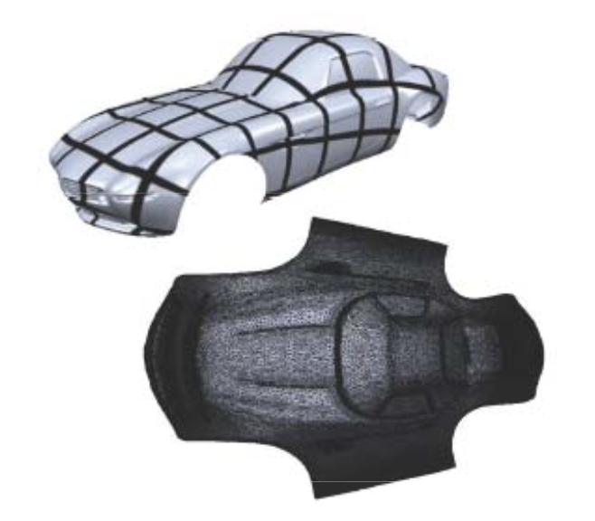
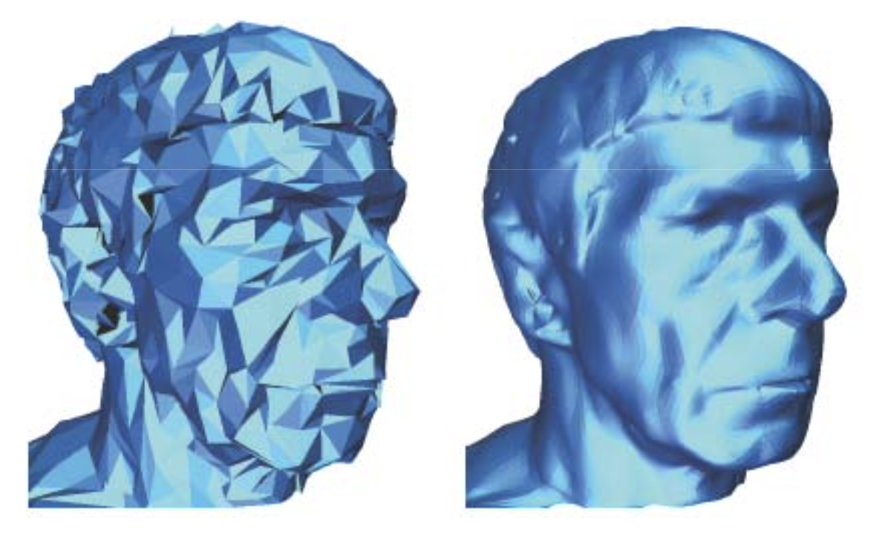
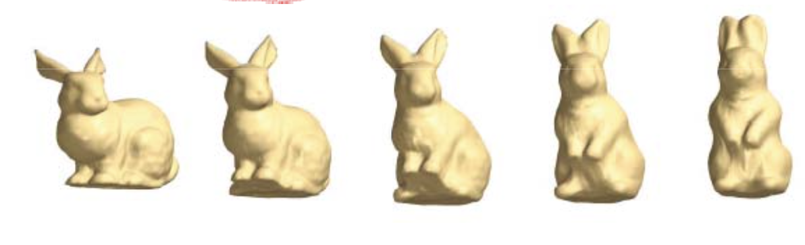
Applications
Essential for Mesh Processing
Parameterization
Editing
Reconstruction
Morphing
Notes:
Essential for Mesh Processing, Parameterization, Editing , Reconstruction, Morphing
But linear systems can be applied to many faceds of life such as economy, physics

Slide 5


Structure / Prerequisites
For the development of this library, only 8 standard C++11 libraries have been used:
#include <iostream>
#include <ctime>
#include <memory>
#include <cmath>
#include <vector>
#include <iomanip>
#include <vector>
#include <algorithm>
Notes:
Since the goal of the project was to test our understanding of the concept, only the 8 most essential standard libraries were utilized. We have a base class which have 3 derived classes -following the classic inheritance system.
All the memory management is done through unique pointers. Vectors are used to store the matrix values as well. The structure relies on templated classes meaning the code is written in a way that is independent of any particular type. There is a single definition of each container, such as vector, but we can define many different kinds of vectors for example, vector <int> or vector <double>.

Slide 6
Matrix Types
Dense | Sparse (CSR) | Band | Symmetric
saves strictly all values within an ordinary matrix | consists of three arrays which save the (1) all non-zero values inside a matrix, (2) the row positioning and (3) the column indices of the non zero values | saves only the values inside user-specified diagonals | saves only the upper triangle of of a matrix.
Inverse Gauss Lower–Upper (LU) decomposition Conjugate Gradient(CG) Successive over-relaxation (SOR) Chebyshev | Conjugate Gradient(CG) Successive over-relaxation (SOR) Chebyshev | Conjugate Gradient(CG) Successive over-relaxation (SOR) Chebyshev | Conjugate Gradient(CG) Successive over-relaxation (SOR) Chebyshev
*All matrix types save their values in ROW MAJOR order
Notes:
There are many types of Matrix formats, hence due to the limitation of time constraint for the competition we decided to choose the 4 most common types and implement them.
Firstly, Dense Matrix which is the matrix type everybody usually knows. It is the base class of our library. It holds the private variables of rows, cols and a ’values’ unique pointer array that stores these. The rest of the 3 classes act as child classes which are used when the matrix type fits the description to store and compute in a more efficient manner.
All 4 classes contain individual functions to perform computations such as Multiplication and their own implementation of the linear solvers. In the next slide, I will go to more detail about each.

Slide 7
Dense - Matrix base class
Helper functions:
fillRandom
fillZeros
fillOnes
makeIdentity
generateSPD - O(N²)
printValues/Matrix
countNonZeros
Matrix Operation:
inverse
cofactor
Transpose
MatSum
Trace
determinant
adjugate
upper_triangle
back_substitution
for_substitution
luDecomposition
matVecMult - O(N²)
matMatMult - O(N³)
Linear Solvers:
linear_solver_inv
gaussian_elim
LUSolve - O(N³)
conjugateGradient
SOR
chebyshevIter
multiConjugateGradient
multiSOR
Notes:
Most of the implemented functions are self-explanatory and more complex ones have comment on how we implemented with links to articles/papers that was used.
We can divide our functions into 3 categories. The helper functions that assist the user in creating Matrix and tools to analyse it. Linear Solver that provide the actual answer we are looking for and the Matrix operation functions that are called by the Solvers.
generateSPD() is a helper function that generates Symmetric Possitive Definite Matrices. It receives an integer as input (the type of SPD matrix to be produced - check Matrix.h). For every matrix type, the algorithm loops over all rows and columns using nested for loops; thus, the time complexity of our algorithm is O(N²).
matVecMult() and matMatMult() perform matrix-vector and matrix-matrix multiplications. matVecMult() has a loop than runs N times and a nested loop that runs N times as well; thus, the complexity of this algorithm is O(N²).
matMatMult() has three loops that run N times, two of which are nested; that results in a time complexity of O(N³).
luDecomposition() performs the LU decomposition on our matrix. The algorithm iterates through N rows, for the first row it makes 2N(N-1) operations, for the second 2(N-1)(N-2) and so on; thus, the overall complexity of our algorithm is of the order O(N³).

Slide 8
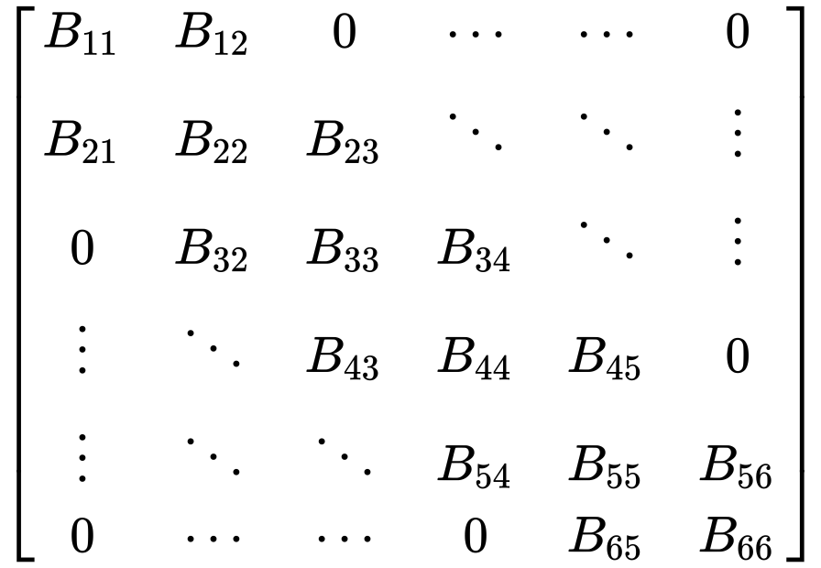
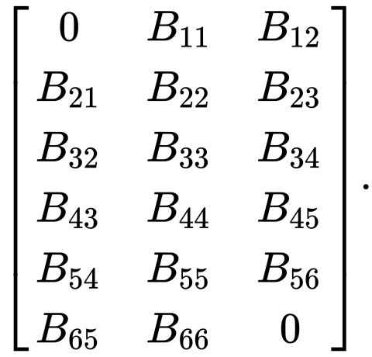


Spare
Band
N x M
N x N
Symmetric
Rest of the 3 types all have dense2<type>, <type>2dense and Print
Everything else is inherited from dense Matrix class
Notes:
CSRMatrix is derived from dense matrix and corresponds to a sparse matrix stored in a CSR format. CSR uses the values array to store the non-zero values as well as two extra arrays to store row and column positions. This format allows for fast row access and matrix-vector multiplications. Using this format we have the advantage of saving up space and doing less operations when we compute matrix-vector and matrix-matrix multiplications. One drawback would be that iterating over the elements of the sparse matrix requires access to all three different arrays; depending on the situation memory jumps can be quite expensive and thus hinder the performance instead of elevate it.
matVecMult() is similar to the base class. The main difference is that instead of iterating over all rows and columns, we take advantage of the CSR format and iterate over row position, using those indexes to access the column elements. Thus, the time complexity of this algorithm is O(N²)
In order to compute matMatMult() we decided to compute the individual multiplication results, together with row and column indexes in a vector of matRestructure. To elaborate, instead of adding the values during the for loop, we store them at each iteration and end up with a list of all non zero values with their position indexes (on the output matrix). To add them together, first sort them according to column (compareMatResInner()) and then row (compareMatResOut()). Then, we iterate through the sorted matRes elements and populate the output matrix’s (values, row position and column index). The time complexity of this algorithm O(N³).
BandMatrix is the banded form of a dense matrix. BandMatrix stores only the elements in the bands of the dense matrix. Essentially, from an NxN dense matrix, we get a NxM matrix, where M is the number of bands. The structure of the class is changed accordingly. With this format, we can greatly decrease the amount of memory required to store a given matrix and also speed up our computations, since we will only iterate over the bands instead of all the columns.
As with our Matrix and CSR class, a number of helper and operation functions have been implemented. We defined the functions dense2band() and band2dense() to transform a matrix from dense to banded form and vice-versa.
The function matVecMult() performs the same operation as the base function. This time however, the computation is much faster, since instead of iterating over all the columns, we only need to iterate through bands. As a result, we can have significant speed-up since the time complexity of this function is now O(MN).
A symmetric matrix is a square matrix that is equal to its transpose, hence halving the storage required. As usual, symm2band() and symm2dense() are used to transform a matrix from dense to banded form and vice- versa. A MatVecMult has also been implemented for use by the Solvers.

Slide 9
Solvers
Solver / Matrix Type | Dense | Sparse - CSR | Band | Symmetric
Inverse | X
Gaussian Elimination | X
LU Solver | X
Conjugate Gradient | X | X | X | X
SOR | X | X | X | X
Chebyshev Iterative | X | X | X | X
Multi CG | X
Multi SOR | X
Notes:
As mentioned in the introduction, a number of linear solvers have been implemented, all of which are used for a default dense matrix.
3.1 Inverse Solver
This is the most basic solver we implemented. We use the inverse function to compute the inverse of input matrix and then we perform a matVecMult operation between the inverse and the input vector. This algorithm uses operations such as determinant(), coFactor() and adjugate() helper functions and as a result has a pretty high time complexity O(N⁴).
3.2 Gaussian Elimination
This is also a fairly basic solver. It computes the upper triangular matrix of our input matrix and performs back substitution to find the solution to our linear system. The complexity of this algorithm will depend on the individual complexities of two functions (since they are called sequentially). The upper triangle function has a time complexity of O(N³). back substitution has a time complexity of O(N²). As a result, the overall time complexity of our Gauss Elimination is O(N³).
3.3 LU Solver
The LU solver calculates the Lower and Upper decompositions of our input matrix, then it performs a forward substitution between the Lower matrix and the input vector, followed by a backward substitution giving the result to the linear system. The time complexity for the LU decomposition is O(N³) the forward and back substitutions have a time complexity of O(N²). Thus, the overall time complexity of this solver is O(N³).
3.4 Conjugate Gradient
The Conjugate Gradient method is here implemented as an iterative solver. It is capable of computing for all the matrix types implemented in this library. The conjugate gradient takes adjutage of the Symmetric Positive Definite Matrices by exploiting its properties.
3.5 SOR
The Successive Over-Relaxation (SOR) method is an iterative solver that make use of an relaxation factor omega given by the user. Omega can take values between 0 and 2 (0 < omega 2). When omega is set to 1 the SOR is equivalent to the Gauss-Seidel (and Jacobi).
3.6 Chebyshev
Lastly, implementented is a version of Chebyshev. This iterative solver takes advantage of extra information (namely the upper and lower estimate of eigenvalues) provided by the user to avoid computation of inner products (as they can be quite expensive). Our algoithm’s performance depends on the number of iterations, the input information given by the user and the performane of matVecMult. Assuming that the algorithm converges given the upper limit for iterations, the time complexity of Chebyshev is identical to matVecMult.
3.7 Multi Linear Solvers
Versions of SOR and CG were implemented to solve multiple vectors in matrix form. Essentially we solve multiple linear systems were the b vectors are stacked as a matrix.

Slide 10
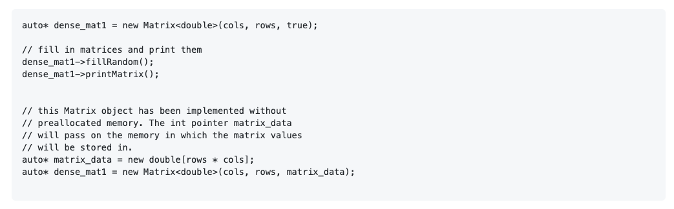
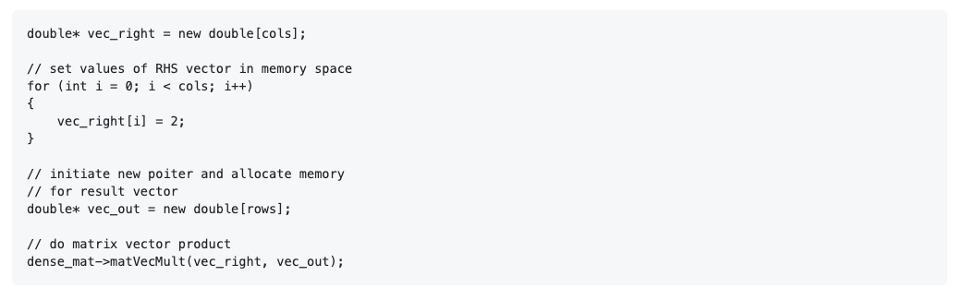
Creating a matrix
Call a function
Notes:
Here, we can see a demonstration on how to create a matrix and call functions we created. Header file contain in-depth explanation on how to call the functions which I can go through if needed.

Slide 11


Installation
Clone this repo to your local machine using:
Installation
Testing
Test file runs all the available linear solvers for the 4 matrix types.
Includes result comparison and time taken.
Notes:
These instructions will get you a copy of the project up and running on your local machine for development and testing purposes. See deployment for notes on how to deploy the project on a live system.

Slide 12
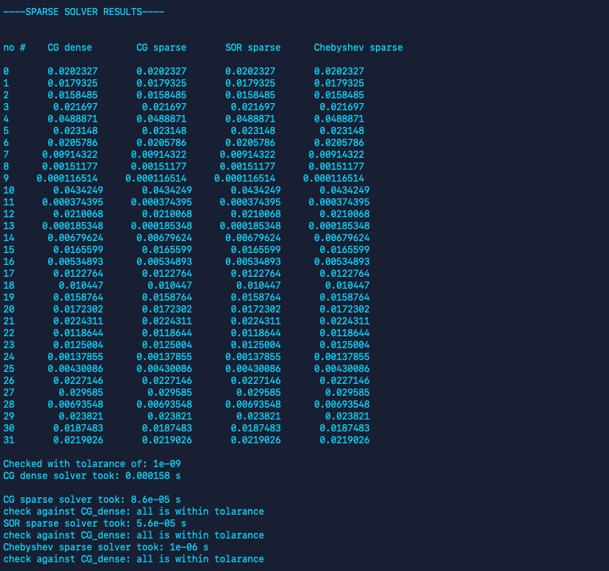
Example of Test result for Sparse
Can set size – Rows x Column & Tolerance
32x32 & 10e-10
Notes:
We have created pretty detailed test file that tests all of our functionates and Includes result comparison and time taken.
Compare the time difference between the solvers!

Slide 13
Benchmark
Tests have been conducted on University HPC servers
10x10
100x100
1000x1000
10000x10000
Strength & Weakness
Architecture built for easy expansion
Well organised code
Generic use for all classes
Simple name selection
Not fully developed
Benchmarking has no analysis
Notes:
Data analysis have been conducted via the HPC - high performance computing at Imperial College London. However, due to the pressing time issues and HPC being heavily occupied a report analysis is not available at this time. Here are the sizes we conducted with:

Slide 14
Team
Team of 3 graduate students
Took about 10 days to develop
A lot of Brainstorming sessions and debugging together
Team with the most diverse and efficient functions in the competition
What’s next?
Finish implementing MatMatMult for band & symmetric matrix
Explore parallelise with openMP
Develop a function to analyse the input matrix and direct it to the most appropriate class.
Notes:
OpenMp mention Game of life and Smooth Particle Dynamics
Later on we took on a course on paralizationand applied it to range of problem from trivial such as game of life to more complex simulators such as Smoothed Particle Hydrodynamics.

Slide 15
Thank you for listening Questions ?
Notes:
(what we would do differently next time)
At the very begging, draw a map of all Classes/sub-classes and functions belonging to it.
Write up the templete file for the entire programme from the very beginning.
Write comments whilst coding.
Maintain the team communication on a level as high as this time.

